Slide 1
3D képszintézis fizikai alapmodellje
Science is either physics or stamp collecting.
Rutherford
Szirmay-Kalos László

Slide 2
3D képszintézis
Tone
mapping
pixel
Virtuális világ
λ
λ
szín
Valós világ
λ
λ
λ
Notes:
In order to compute the image, the power arriving at the eye from the solid angle of each pixel needs to be determined on different wavelengths.
We establish a virtual world model in the computer memory, where the user is represented by a single eye position and the display by a window rectangle. Then we compute the power going through the pixel toward the eye on different wavelengths, which results in a power spectrum.
If we can get the display to emit the same photons (i.e. the same number and of the same frequency), then the illusion of watching the virtual world can be created. As the human eye can be cheated with red, green, and blue colors, it is enough if the display emits light on these wavelengths. The last step of rendering is the conversion of the calculated spectrum to displayable red, green and blue intensities, which is called tone mapping. If we compute the light transfer only on these wavelengths, then this step can be omitted and the resulting spectrum can be used directly to control the monitor.
One crucial question is what exactly should be computed that describes the strength of the light intensity and when the pixel is controlled accordingly, provides the same color perception as the surface. Note that the pixel is at a different distance than the visible surface. The orientations of the display surface and of the visible surface are also different. The total emitted power would definitely be not good since it would mean less photons for the eye for farther sources.

Slide 3
Színérzékelés: monokromatikus fény
1 egys
b
g
r
λ
nm
λ
r, g, b
444
526
645
λ színérzete: r, g, b
2
g(λ)
r(λ)
1
b(λ)
400
500
600
700
Notes:
Light is an electromagnetic wave, color is just an illusion created by the human eye and the brain. As the eye is a poor spectrometer, we can cheat it with a different spectrum, the eye cannot tell the difference. This fact is exploited by displays, which can emit light just around three wavelengths. So the task is to convert the computed spectrum to the intensities of the three lamps associated with a pixel. To solve this, we should understand how the illusion of color is created. As the illusion is deep in our brain, we can use only subjective comparative experiments to find out what color means.
In our experiment, we have two white sheets, the first is illuminated by a unit radiance monochromatic light beam of wavelength lambda, the other is by three lamps of controllable intensities and of wavelengths, say, 444, 526, 645 nanometers, which could be seen as red, green and blue (we could choose other reference wavelengths as well, they just have to be far enough; this particular selection is justified by the fact that there exist materials that emit light on these wavelengths). A human observer sits in front of the two white sheets and his task is to control the intensities of the three lamps in order to eliminate any perceived difference between the two sheets. If it happens, the monochromatic light and the controlled three component light provide the same color and are called metamers. If the same experiment is repeated in many discrete wavelengths, three color matching functions can be obtained.
Note that the red and the green matching function have negative parts as well, which means, for example, that the 500 nm light can be matched only if some red is added to it.
In the second experiment we can try to match two, three, etc. component light beams and beams of non-unit intensity. We will come to the conclusion that the corresponding r,g,b values of polychromatic light are the sums of the r,g,b, primaries of the monochromatic components, and also that if the intensity of the beam is not unit, then the r,g,b intensities should also be multiplied by the same factor. This means that colors are linear objects.

Slide 4
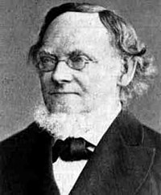
Színérzékelés: polikromatikus fény
(Hermann) Grassmann törvények
Φ (λ)
R = ∫ Φ (λ) r(λ) dλ
G = ∫ Φ (λ) g(λ) dλ
B = ∫ Φ (λ) b(λ) dλ
λ
A színérzet lineáris (Grassmann törvények)
Kétszer akkora spektrumhoz kétszer akkora r,g,b tartozik
Különböző spektrumok összegéhez az r,g,b-k összege tartozik
Notes:
Based on these experiments, we can establish the Grasmann laws of color science. Any spectrum can be matched with three primaries by weighting the monochromatic components by the color matching functions and adding (integrating) different monochromatic components.

Slide 5
Spektrális versus RGB képszintézis
model
R, G, B
model
λ
Képszintézis
sok hullámhosszon
Képszintézis
3 hullámhosszon
λ
Látható
spektrum
R, G, B
színillesztés
R, G, B kép
R,G,B kép
Notes:
A physically plausible simulation would be executed on many wavelengths (note that wavelengths can be handled independently) resulting in a visible spectrum. The final step of rendering is the conversion of this spectrum to red, green, blue intensities, which can be set in the frame buffer, and ultimately on the display.
However, in many cases, we use an approximation. We assume that light sources emit light directly on the wavelengths of the red, green, blue. Thus, we can immediately get the r,g,b, values without any integration. Note, however, that the rendering process is not linear since the products of radiance values and BRDFs are computed, so this simpler option is just an approximation.

Slide 6
Radiancia (sugársűrűség)
Egységnyi látható terület által egységnyi térszögbe sugárzott teljesítmény [Watt/sr/m²]
ΔΦ
L(r,V)
ΔΦ
ΔA cosθ Δω
L(r,V) =
V
Δω
ΔΦ
θ
ΔA cosθ
r
ΔΦ =L(r,V) ΔA cosθ Δω
ΔA
Notes:
We should work with power density instead of the power, that is computed with respect to the solid angle in which the light is emitted and with respect to the size of the projected surface. The density computed as the power divided by the projected surface and the solid angle of emission is called the radiance.
An important theorem states that if two surfaces have the same radiance, then they look identical no matter whether they are at a different distance or have different orientation. The proof is based on that if in a solid angle the eye would gather the same number of photons, i.e. energy, then it would not be able to distinguish the source surfaces. Let us compute this power for two surfaces that are seen in the same solid angle and have the same radiance.
If the surface is closer, then its real area is smaller, but the solid angle in which the pupil of the eye can be reached from this surface is larger. Both the solid angle and the surface changes with the square of the distance and the two factors compensate each other. If the surface is not perpendicular to the viewing direction, then the surface seen in a given solid angle is larger, but the cosine factor will be proportionally smaller, so again we see no difference.
So, the conclusion is that we should compute the radiance of a surface and set the pixel of the display to have the same radiance. Then the two surfaces will be identical for the eye.
The fact that surfaces having the same radiance but at different distances look similar can also be interpreted as that the radiance does not change along a ray.

Slide 7
Fénynél a hullámhosszok külön kezelhetők
e⁻
e⁻
Relativisztikus tömeg és impulzus kicsi: m=E/c² = hf/c², I = hf/c
A foton energia (hullámhossz) nem változik rugalmas ütközésnél
Elnyelődési valószínűség energiafüggő
Notes:
In computer graphics we consider photons in the visible wavelength range, roughly from 300 to 700 nanometer wavelengths. A photon has zero rest mass, otherwise it would not be able to fly with the speed of light. However, it has non-zero energy and impulse. The energy is proportional to frequency f of the light as stated by Einstein who invented this law when examining the photonelectric effect. He got his Nobel prize for this and not for the theory of relativity. Using the equivalence of the energy and mass, which was also published by Einstein as a short paper in 1905, we can assign a relativistic weight to the photon as the Planck constant h multiplied by the frequency and divided by the square of the speed of light.
If f is small, then this relativistic mass is small. When photons meet a material, photons collide or scatter by the electrons or less probably with the core of atoms. For photons belonging to the visible spectrum, the relativistic mass of the photon is much smaller than the mass of the electron, thus a photon bounces off the electron like a ball bounces off from a rigid wall or a billiard ball bounces off from the edge of the table. If the collision is elastic, then the photon energy is preserved and the electron does not change its energy level.
If the collision is inelastic, then the energy of the photons is absorbed by the electron, this is the photoelectic effect, and the number of photons gets smaller. The probability of inelastic scattering, i.e. the albedo associated with a collision is energy dependent.
Summarizing when photons meet electrons, their number may get smaller but their energy level and consequently their frequency remain the same. This is the reason that in computer graphics wavelengths or frequencies are handled independently.

Slide 8
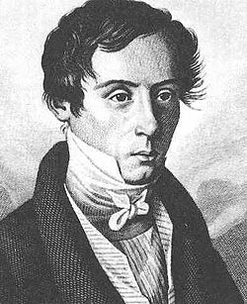
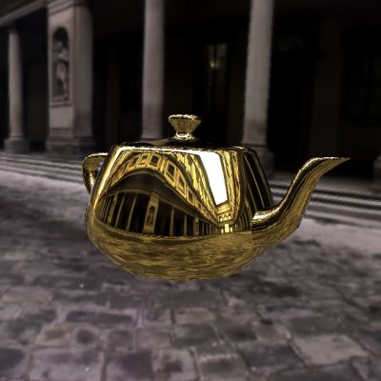
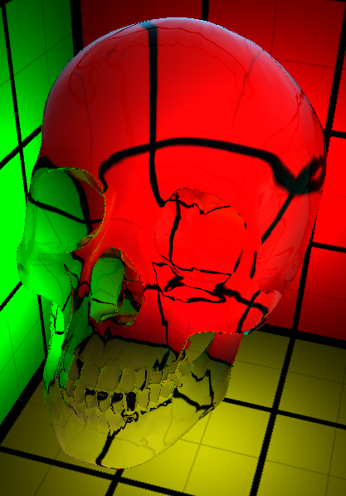
Sima felület: Fresnel egyenlet
„Sima” = 1 pixelben a felület sík
L^{in}
θ^{in}
θ^{in}
L^{in}⋅F(θ^{in})
Snellius-Descartes törvény
n =
sinθ^{in}
L^{in}⋅(1-F)
sinθ
θ
n : a törésmutató, sebességarány
κ : kioltási tényező
(n -1)² +κ ²
F(θ^{in}) ≈ F0+(1-F0)⋅(1-cosθ^{in})⁵, F0 =
(n+1)² +κ ²
Notes:
The simplest arrangement for the light transfer is a single plane that separates the space into two half spaces of different materials. According to the laws of geometric optics, the illumination ray is broken to a relfection ray meeting the reflection law and a refraction ray obeying the Snell’s law of refraction. Here n is the index of refraction, which expresses the ratios of speeds of light outside and inside the material. The Fresnel equations define the amount of reflected energy (i.e. the probability that a photon is reflected). The Fresnel function can be calculated from index of refraction n, extinction k, incident angle theta’ and refraction angle theta. The extinction is negligible for non-metals. We also show a simplified Fresnel term.

Slide 9
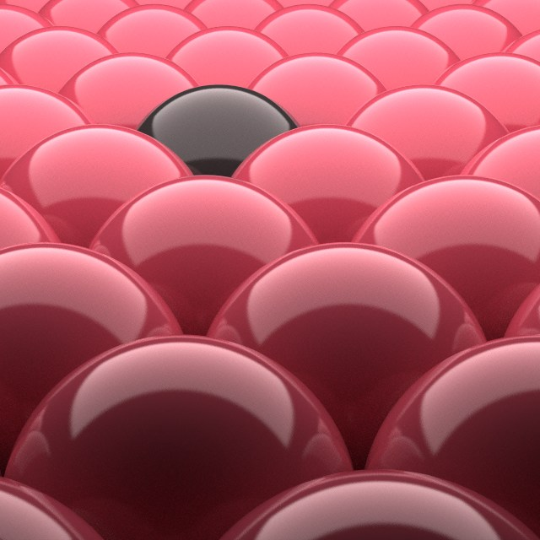
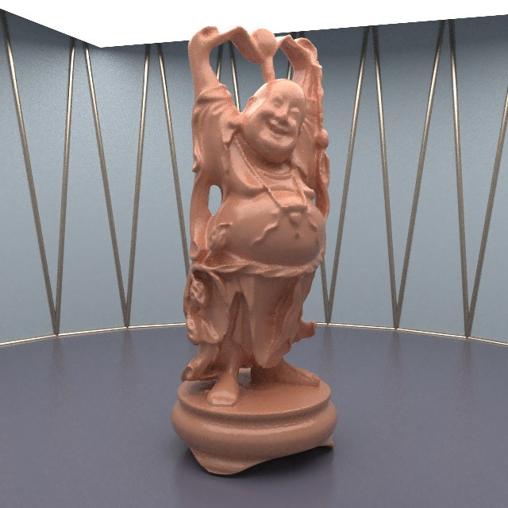
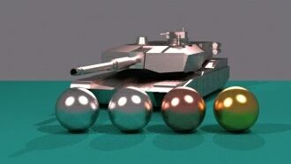
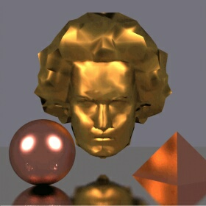
Fresnel függvény
F (λ, θ^{in})
F(λ, θ^{in})
λ
λ
θ^{in}
θ^{in}
arany
ezüst
Notes:
The Fresnel function depends on the wavelength and on the incident angle. When we see an object, we can observe surfaces of many different orientations, so we perceive the Fresnel function as a whole.

Slide 10
Tükörirány
N
cos α = - (v·N)
v + N cosα
v + N cosα
N cosα
R
v
R = v + 2 N cos α
α
α
egységvektor
r
vec3 reflect(vec3 inDir, vec3 normal) {
return inDir - normal * dot(normal, inDir) * 2.0f;
};
vec3 Fresnel(vec3 inDir, vec3 normal) {
float cosa = -dot(inDir, normal);
vec3 one(1, 1, 1);
vec3 F0 = ((n–one)*(n–one) + kappa*kappa) /
((n+one)*(n+one) + kappa*kappa);
return F0 + (one – F0) * pow(1-cosa, 5);
}
(n -1)² +κ ²
(n+1)² +κ ²
Notes:
To render smooth surfaces, we should compute the ideal reflection direction. Assume that incident direction v and surface normal N are unit length vectors.
Incident direction v is decomposed to a component parallel to the normal and a component that is perpendicular to it. Then, the reflection direction is built up from these two components.

Slide 11
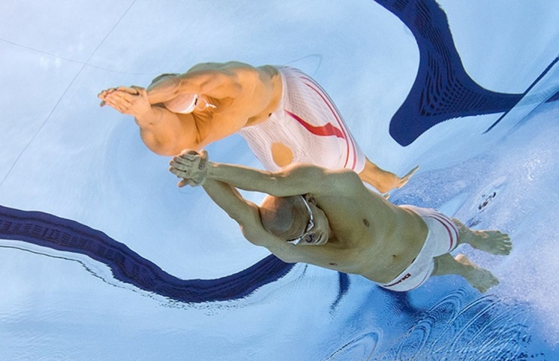
Törési irány
N
v + Ncosα
v +Ncosα
v
N⊥ =
α
sinα
N⊥sinβ
N⊥
T = N⊥ sinβ − Ncosβ
Snellius-
Descartes
-Ncosβ
β
T = v/n + N(cosα/n− cosβ)
cosβ = √1-sin²β = √1-sin²α/n²
sin α
n =
sin β
T
T = v/n + N (cosα/n -√1-(1-cos² α)/n² )
vec3 refract(vec3 inDir, vec3 normal, float ns) {
float cosa = -dot(inDir, normal);
float disc = 1 - (1-cosa*cosa)/ns/ns; // scalar n
if (disc < 0) return vec3(0, 0, 0);
return inDir/ns + normal * (cosa/ns - sqrt(disc));
}
Notes:
The refraction direction calculation is also similar. The refraction direction v_t is expressed as a combination of the normal vector and a vector that is perpendicular to the normal, N_perpendicular. These vectors should be combined with weights cos(beta) and sin(beta) where beta is the refraction angle.
N_perpendicular is expressed from v+N cos(alpha) by dividing it with its length sin(alpha).
Then sin(beta)/sin(alpha) is replaced by the reciprocal of the index of refraction.

Slide 12
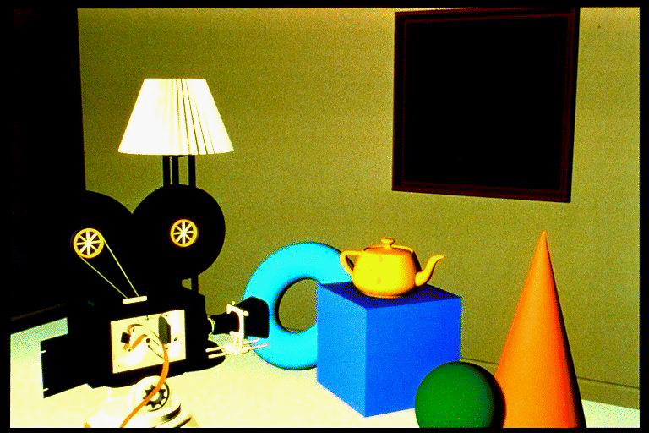
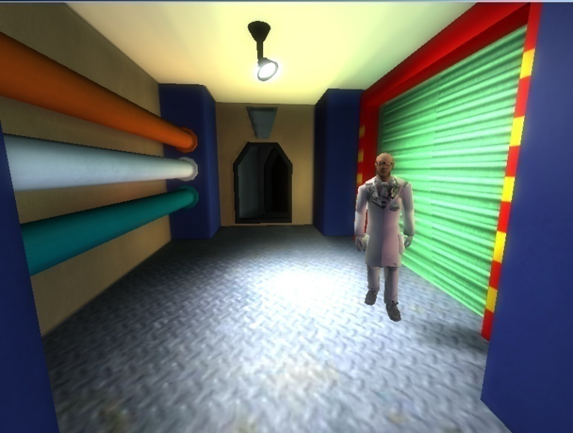
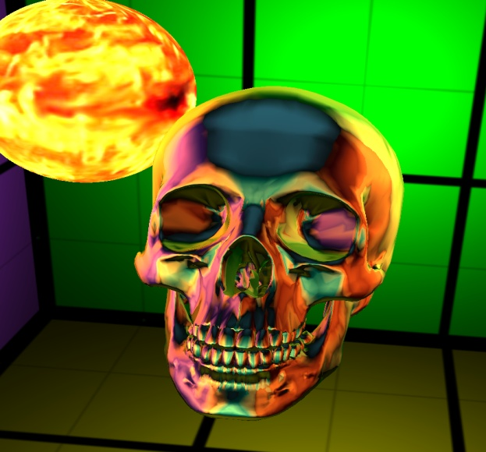
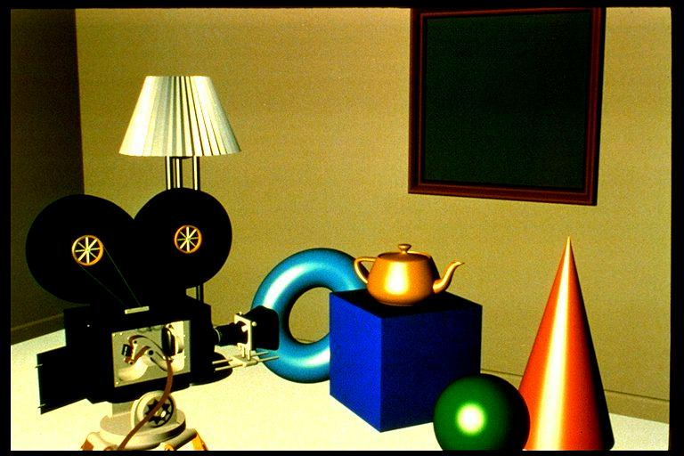
Rücskös felületek
Mikroszkópikus modell:
θ^{in}
1 pixelben látható felület
Mi: viselkedésileg érvényes modell
Notes:
Surfaces are usually not smooth, so they reflect light not just in the ideal reflection direction but practically in all possible directions. Physically, we can imagine these rough surfaces as a random collection of ideal mirror microfacets that reflect light according to their random orientation.
As we see not a single microfacet in a pixel, but a large collection of them, we perceive the average radiance reflected by this collection.
Photons may have a single scattering on these microfaces when the average is maximum around the ideal reflection direction of the mean surface. On the other hand, photons may get scattered multiple times, when they “forget” their original direction, so the reflection lobe will be roughly uniform.
Instead of following a probabilistic reasoning, we handle these rough surfaces as a black-box, i.e. empirical model. That is, we describe the behavior of the surface based on everyday experience without any structural analysis. By experience, we say that a rough surface reflects light into all directions, but more light is reflected into the neighborhood of the ideal reflection direction.

Slide 13
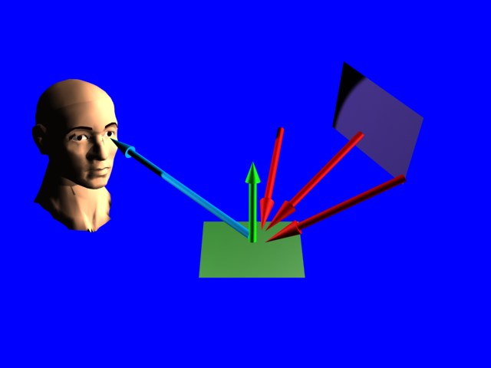
Fény-felület kölcsönhatás
Radiancia = Irradiancia ⋅ BRDF
L(r,V) = L^{in}(r,L) ⋅ cosθ^{in} ⋅ f_{r} (L,r,V)
def
L (r,V)
L^{in}(r,L)⋅cosθ^{in}
L-ből V-be vert arány
f_{r} (L,r,V) =
Helmholtz törvény:
θ^{in}
L
f_{r} (L,r,V) = f_{r} (V,r,L)
V
L^{in}
L^{in}
θ^{in}
1
r
1/cosθ^{in}
Notes:
The reflected radiance of a surface depends on the irradiance and the likelihood of the reflection. The irradiance is the incident radiance and a geometric factor that expresses that the illumination is weaker if the light arrives from a non-perpendicular direction since a unit cross section light beam illuminates a larger surface on which the photons are distributed. This cosine term is also called the geometric term and term expresses that a non perpendicular illumination is spread over a larger surface. The likelihood of reflection is expressed by the Bi-directional Reflectance Distributrion Function. In real life, BRDFs are symmetric.

Slide 14
Diffúz visszaverődés
V
N
L
θ^{in}
Radiancia = Irradiancia ⋅ BRDF
A nézeti iránytól független
A BRDF a nézeti iránytól független
Helmholtz: a BRDF megvilágítási iránytól is független
A BRDF irányfüggetlen:
Diffúz visszaverődés = nagyon rücskös
sokszoros fény-anyag kölcsönhatás
színes!
r
f_{r} (L,r,V) = k_{d}(r,λ)
Notes:
Our first model is for very rough surfaces where all photons get reflected multiple times. Such materials (snow, sand, wall, chalk, cloth etc) have a matte look, they look the same from all viewing directions. Thus, the radiance, which equals to the incident radiance times the BRDF times the geometry term, is independent of the viewing direction. Incident radiance and the geometry term are already independent of the viewing direction, thus the BRDF must also be independent of the viewing direction. According to Helmholtz reciprocity, if the BRDF is independent of the viewing direction, it must be independent of the illumination direction as well, so the BRDF is direction independent.
Diffuse surfaces correspond to very rough surfaces where a photon collides many times. The Fresnel depends on the wavelength, which is strong for metals and weak for non-metals. Even if a single reflection changes the spectrum just a little, multiple reflections amplify this effect, so the final reflected light will have a modified spectrum. Diffuse reflection is primarily responsible for the “own color” of the surface.

Slide 15
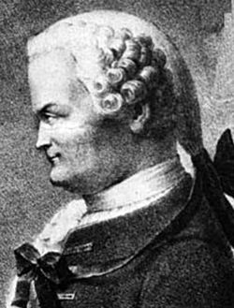
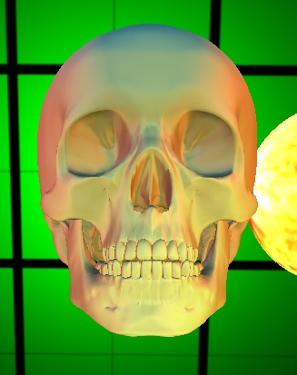
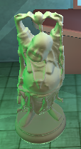
(Johann Heinrich) Lambert törvény
Pont/irány fényforrásra válasz
BRDF irányfüggetlen, DE a sugársűrűség függ a megvilágítási iránytól
L^{ref} = L^{in} k_{d} cos⁺θ^{in}
cosθ^{in} = N·L
N
L
θ^{in}
Notes:
The reflected radiance is the incident radiance times the BRDF, which is constant now, and the geometry term. So for diffuse surfaces, the reflected radiance is proportional to the cosine of the orientation angle. This cosine can be computed as a dot product of the unit surface normal and the unit illumination direction.
If the cosine is negative, i.e. the angle between the surface normal and the illumination direction is greater than 90 degrees, then the illumination is blocked by the object whose surface is considered. In such cases, the negative value is replaced by zero.

Slide 16
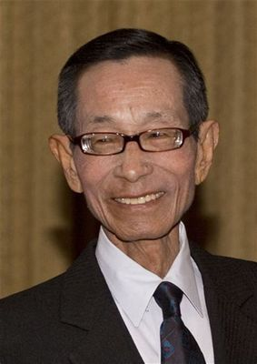
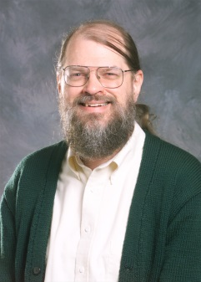
Spekuláris visszaverődés (Phong (Bui) - (Jim) Blinn modell)
k_{s}(cos⁺δ)^{shine}
Halfway vektor
cosδ=Ν·Η
Nézeti irányfüggő
H = (L+V)/|L+V|
δ
N
θ^{in}
= diffúz +
L
θ^{in}
V
V
L^{ref} = L^{in} k_{d} cos⁺θ^{in} +
= L^{in} (k_{d} + )cos⁺θ^{in}
L^{in} k_{s} (cos⁺δ)^{shine}
k_{s}
(cos⁺δ)^{shine}
cos⁺θ^{in}
Notes:
Shiny, glossy or specular surfaces also reflect the light in all possible directions, but they look differently from different viewing directions. We can observe the blurred reflection of the light sources, thus they reflect more light close to the ideal reflection direction.
We model such surfaces as a combination of diffuse reflection where the radiance is constant and a specular reflection where the radiance is great around the ideal reflection direction. According to the microfacet model, diffuse reflection is caused by multiple light microfacet interaction while specular reflection is the result of a single light microfacet interaction. In order to model the specular reflection lobe, we need a function that is maximum at the reflection direction and decreases in a controllable way if the viewing direction gets farther from the reflection direction. Phong and Blinn proposed the cos^shininess(delta) function where delta is the angle between the macroscopic surface normal and the microfacet normal. The shininess exponent defines how shiny the surface is.

Slide 17
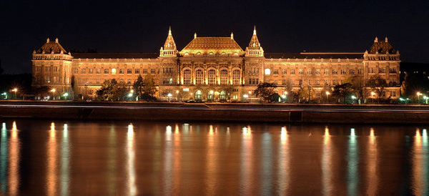
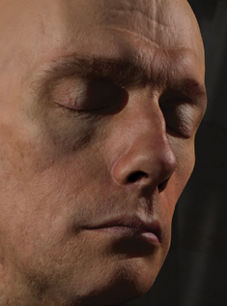
Phong-Blinn modell nem tökéletes
Még a K épületet sem tudja éjszaka (aranyhíd)
Nem szimmetrikus (sérti a fizikát)
Pl. javítás:
(cos⁺δ)^{shine}
L^{ref} = L^{in} (k_{d} +k_{s} )cos⁺θ^{in}
(L+V)²

Slide 18
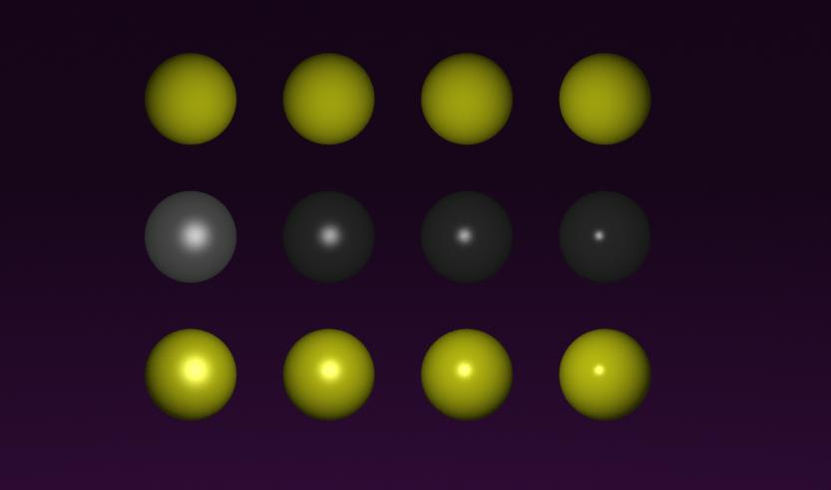
Diffúz+Phong anyagok
Sokszoros fény-anyag
kölcsönhatás
„Saját szín”
diffúz
Egyszeres fény-anyag
kölcsönhatás,
nemfémeknél
hullámhossz független
Phong
diffúz +
Phong
shininess =
5 10 20 50
Notes:
Diffuse reflection simulates multiple light-surface interaction and is colored. Specular reflection is the model of the single light-surface interaction and it is proportional to the Fresnel function. For non metals, the wavelength dependence of the Fresnel is moderate, so for non metals the specular reflection is said to be ”white”.

Slide 19
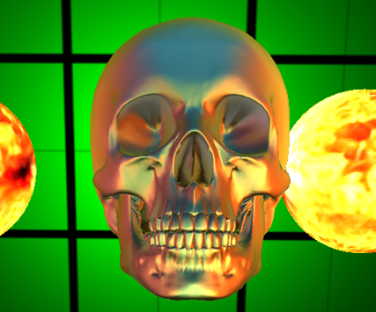
RoughMaterial
// unit N unit V unit L
vec3 shade( vec3 normal, vec3 viewDir, vec3 lightDir,
vec3 inRad) {
float cosTheta = dot(normal, lightDir); // unit vecs
if(cosTheta < 0) return vec3(0,0,0); // self shadow
vec3 diffuseRad = inRad * kd * cosTheta; // diffuse
vec3 halfway = normalize(viewDir + lightDir);
float cosDelta = dot(normal, halfway);
if(cosDelta < 0) return diffuseRad;
return diffuseRad + inRad * ks * pow(cosDelta, shine);
}

Slide 20
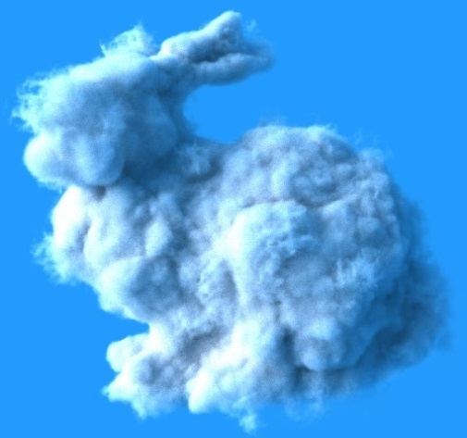
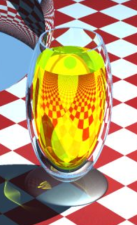
Fényelnyelő
$$ds$$
A=1
$$σ\left(s\right)ds=P\{ütközés\}$$
Hatáskeresztmetszet,
alias kioltási tényező
[1/m]: egységfüggő!
$$L\left(s+ds\right)=L\left(s\right)−L\left(s\right)σ\left(s\right)ds$$
$$\frac{dL\left(s\right)}{ds }=−L\left(s\right)σ\left(s\right)$$
$$\int_{L(0)}^{L(S)}{} \int_{0}^{S}{}$$
$$\frac{dL}{L}=− σ\left(s\right)ds$$
$$L\left(S\right)=L\left(0\right)e^{−\int_{0}^{S}{σ\left(s\right)ds }}$$
$≈L\left(0\right)e^{−\sum_{i}{σ\left(s_{i}\right)∆s}}$
$$\ln\left(L\left(S\right)\right)−ln⁡(L\left(0\right))=−\int_{0}^{S}{σ\left(s\right)ds }$$

Slide 21
Fényforrások
r
E(r,V,λ)
Geometria+sugársűrűség:
Absztrakt fényforrások:
Irány fényforrások: egyetlen irányba sugároz, a fénysugarak párhuzamosak, az intenzitás független a pozíciótól
Pozicionális fényforrás: egyetlen pontból sugároz, az intenzitás a távolság négyzetével csökken
V
L^{in} állandó
L^{in} fordítottan
arányos d ²-tel
d
irány
pozicionális
Notes:
Real light sources are defined by their emission radiance, L^e. When the reflected radiance of a point is considered, the contribution of all those light source points should be added which are visible from the point of interest. This means integration. Thus, we often prefer abstract light source models, that can illuminate a surface just from a single direction, which saves integration.
In case of directional light sources, the radiance is constant everywhere, so is the illumination direction. In other words, the illumination rays are parallel. The Sun is an example for directional light source if we are on the Earth.
For point light sources, the illumination direction points from the location of the source to the illuminated point. The radiance decreases with the square of the distance.
If we ignore the dependence of the radiance on the distance, directional light sources can be considered as point sources being at infinity.

Slide 22
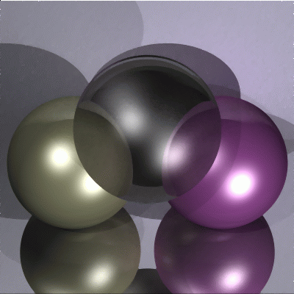
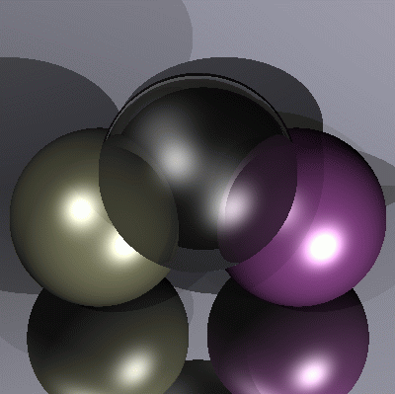
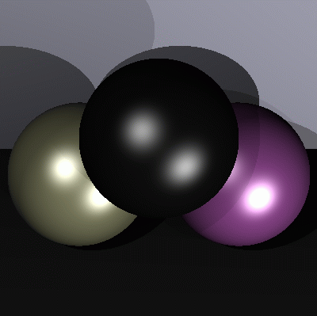
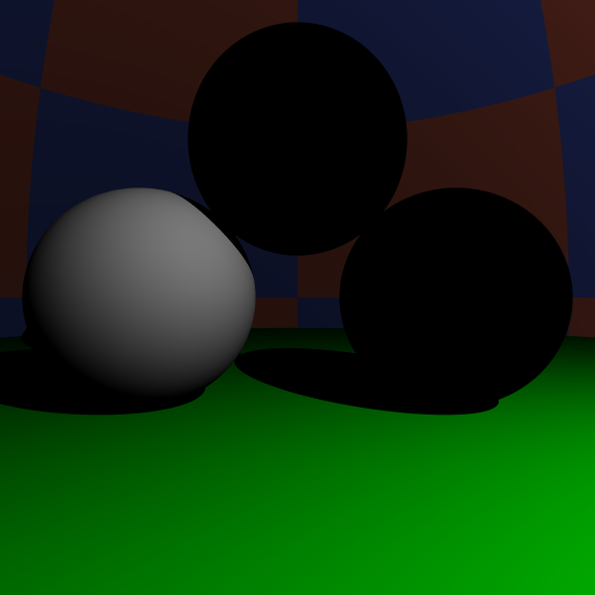
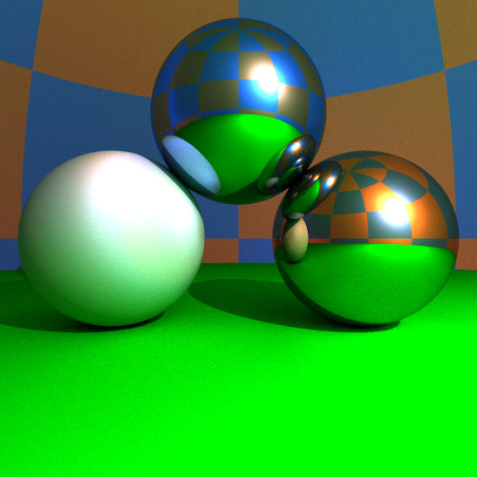
Képszintézis
pixel
lokális illumináció
rekurzív sugárkövetés
globális illumináció
Notes:
Rendering requires the determination of the surface that is visible through a pixel, then the computation of the radiance of this surface in the direction of the eye. There are different tradeoffs between accuracy of the light transport computation and the speed of the computation.
In the local illumination setting, when the radiance of a surface is calculated, we consider only the direct contribution of the light sources and ignore all indirect illumination.
In recursive ray tracing, indirect illumination is computed only for smooth surfaces, in the ideal reflection and refraction directions.
In the global illumination model, indirect illumination is taken into account for rough surfaces as well. In engineering applications we need global illumination solutions since only these provide predictable results. However, in games and real time systems, local illumination or recursive ray tracing will also be acceptable.

